Slide 1
Final Project – Mobile Health
Ian Roberson

Slide 2
The Original Idea
My original idea was to take an image of a body part and scan for abnormalities, cuts, bruises, etc. However, as I was thinking about it, this idea serves little purpose. You can clearly see your own skin, rendering this idea redundant.

Slide 3
Bone Breakage Detection
For my final project I'd like to make a program that takes an x-ray image of a body part and scans for fractures in the bone, as you cannot see the bones inside your body. Due to the complexity of the human skeletal structure and the time constraint of this project, the program will likely be unable to work for the entire skeleton. Therefore, I will primarily be focusing on a handful of bones, such as the arm or leg.
Note: New idea pushes the 'mobile' requirement

Slide 4
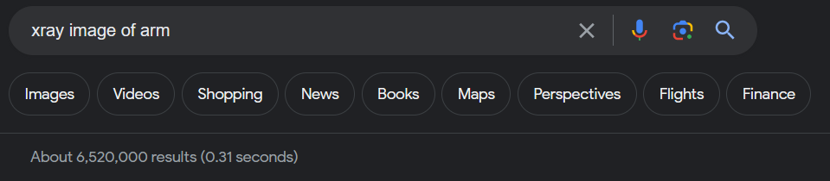
Data Acquisition
X-Ray images in png/jpeg form can be obtained from public domain sites, such as google images
Note: in the medical field DICOM files are used instead of png/jpeg files to provide sharper images, but DICOM files can be losslessly converted to png/jpeg with free, preexisting programs

Slide 5
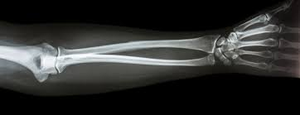
Base Case
Determine what is a bone and what isn't (remove the noise from the flesh and muscles)
Detect major cracks (full breaks) in the bone of a given body part (arm or leg) and label them

Slide 6
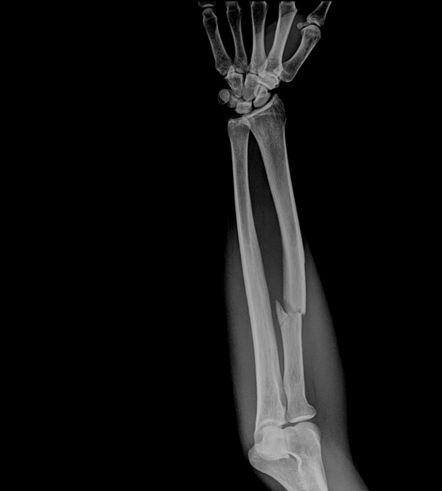
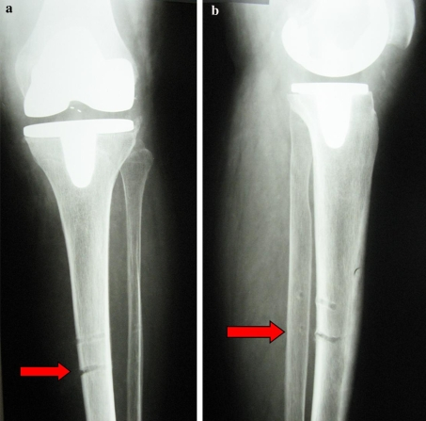
Expansions
Determine the severity of the crack (detect micro cracks)
Differentiate different bone types

Slide 7






Questions

